Slide 1

Loan prediction
Presentation by: ghada ahmed Elsayed
ENG:. YOssef Elbarody

Slide 2


Intro to the project
o1.
Predict loan and whose applicant deserve it
o2.
From his customer information we know predicted loan
o3.
Customer info like[id, status, education, loan amount ,loan_ status credit history ] all this from LOAN Dataset

Slide 3

common problem
The company seeks to automate (in real time) the loan qualifying procedure based on information given by customers while filling out an online application form. It is expected that the development of ML models that can help the company predict loan approval in accelerating decision-

Slide 4

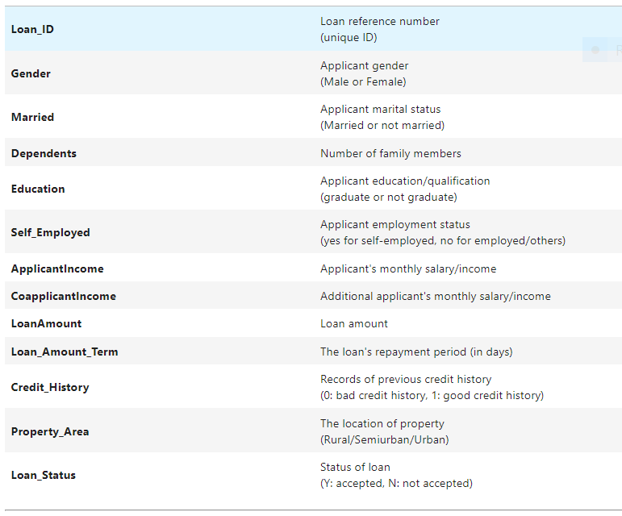
Here: Knowing LOAN Dataset

Slide 5
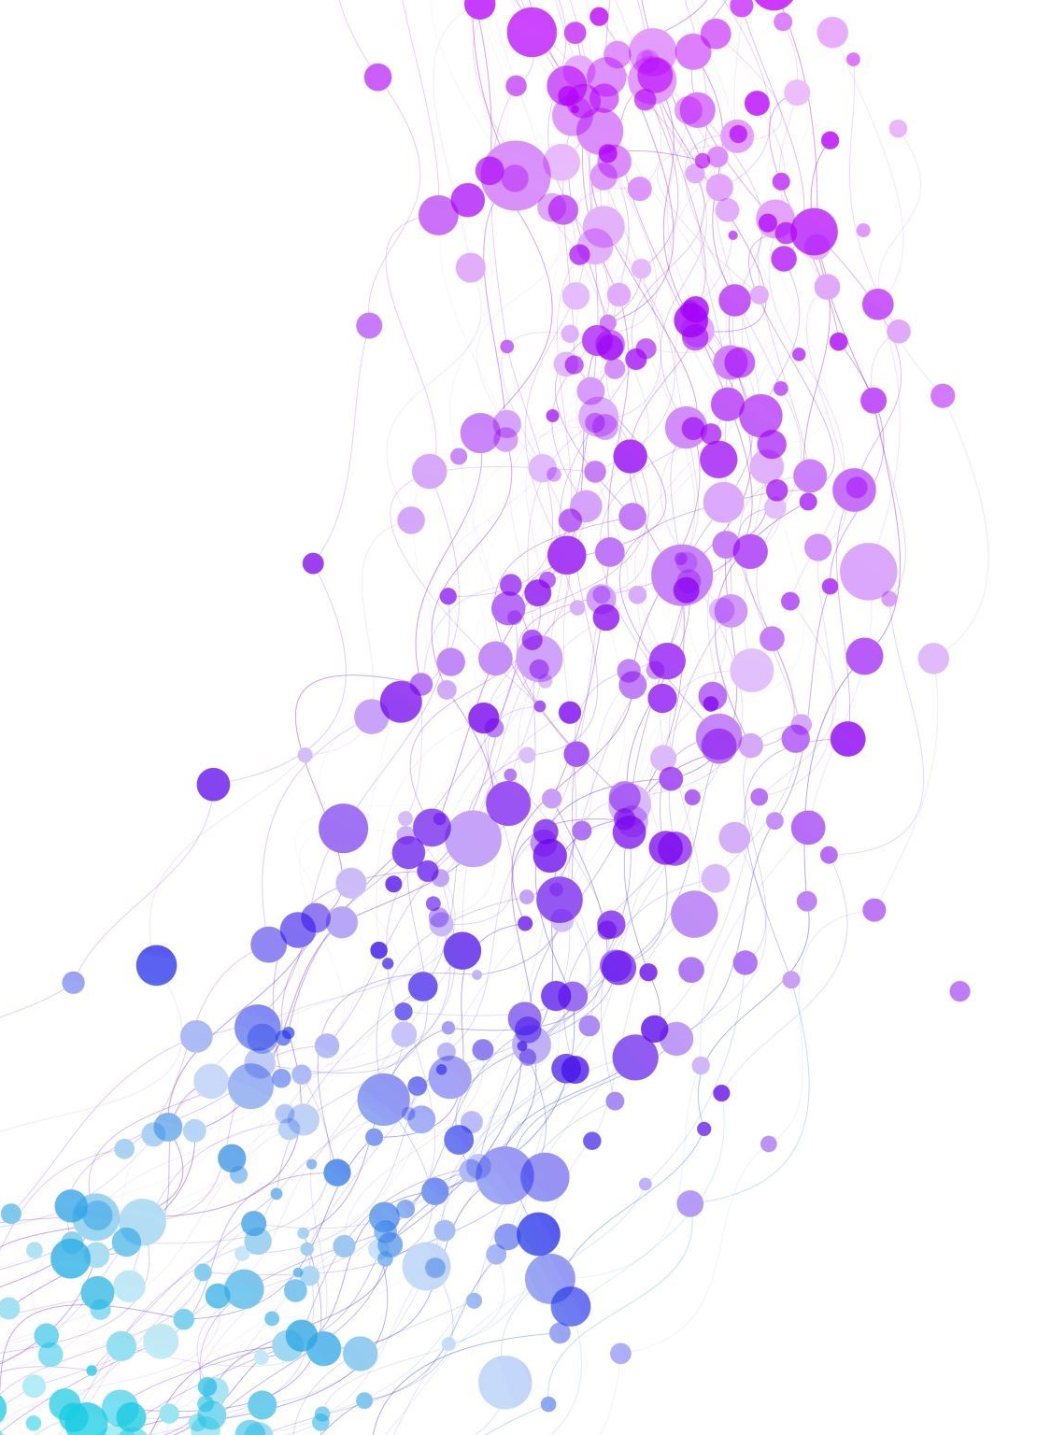
Loan Dataset
There are13 variables in this data set:
8 categorical variables,
4 continuous variables,
1 variable not necessary the loan ID.

Slide 6
LOAN Dataset
LOANID : Unique Loan ID
Gender : Male/ Female
Married : Applicant married (Y/N)
Dependents : Number of dependents
Education : Applicant Education (Graduate/ Under Graduate)
Self-employed : Self employed (Y/N)
Applicant Income : Applicant income
CooApplicantIncome : Co-applicant income
Loan-Amount : Loan amount in thousands of dollars
Loan-Amount-Term : Term of loan in months
Credit-History : credit history meets guidelines yes or no
Property-Area : Urban/ Semi Urban/ Rural
Loan-Status : Loan approved (Y/N) this is the target variable

Slide 7



Main step in my project
Loading Data
Discover Features
Cleaning & preprocessing
Loan data from Kaggle have
13 columns
552 entries
Visualize each feature with its count and data type to clean data
Get rid of null Values
Outliers feature engineering

Slide 8



Second step in my project
Splitting Data
Split train to target as (y) train to (X)
SVM&
Grid Search
Loan data(L1) split to train (x,y)
Test(x,y)
Split X as all data without label (12 feature)
y=(1 feature) and use scaler to normalize data
MinMAx
For best score and reduce overfiting

Slide 9
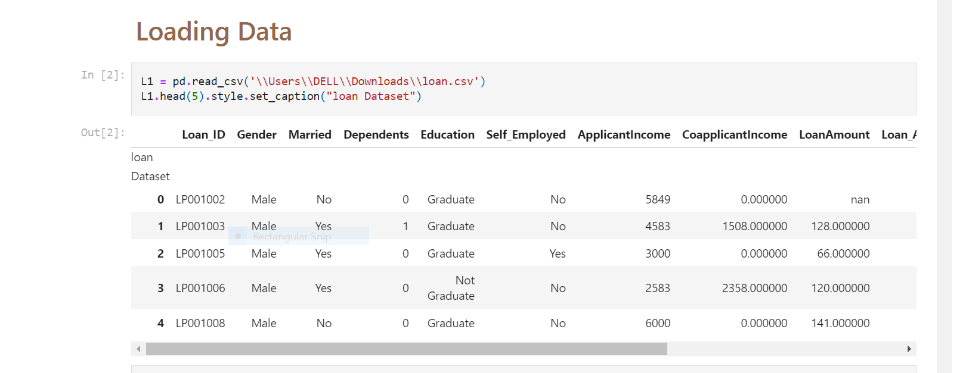
Loading Data
Data having:
.

Slide 10
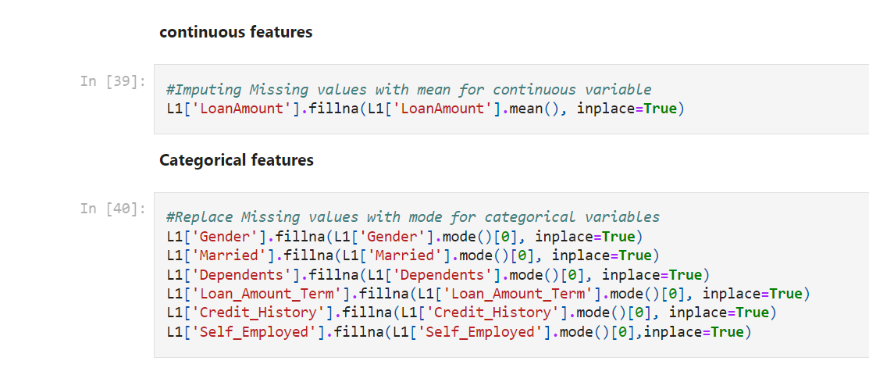
preprocessing
Effective Strategies for Handling Missing Values in Data Analysis:
1.Deleting the entire column
2.Imputing the Missing Value
(Replacing with the mode-median- forward fill-backward fill)
.1-continuous features->mean [loan_amount]
2-Categorical features ->mode()[0]

Slide 11
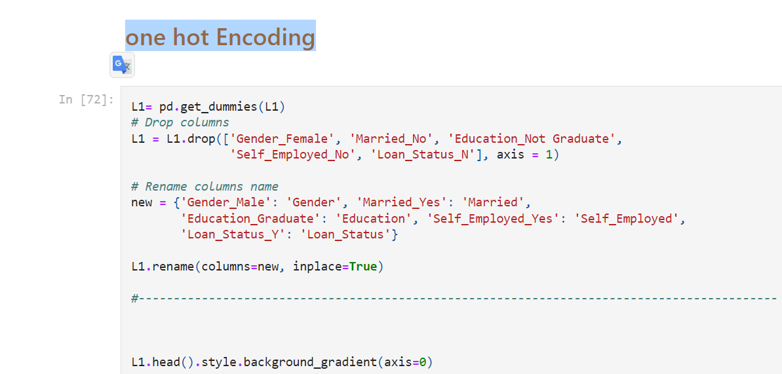
preprocessing
Encoding :using One Hot Encoding
.

Slide 12
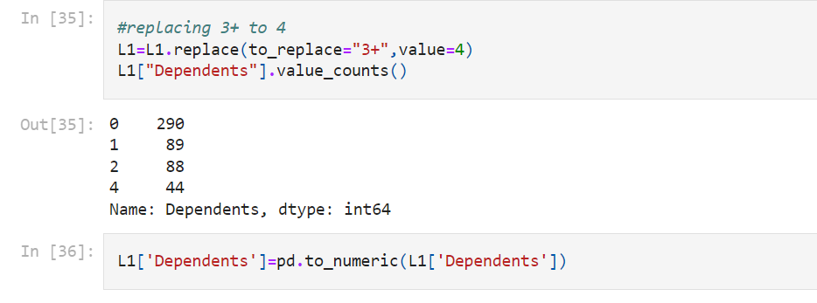
preprocessing
Convert Dependents Feature
.

Slide 13
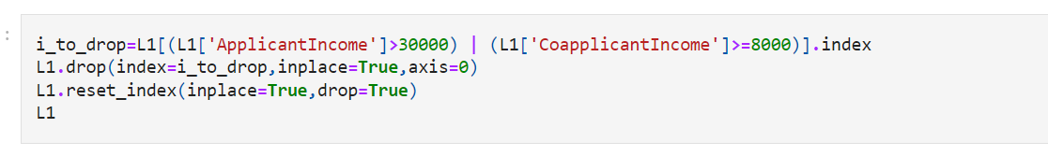
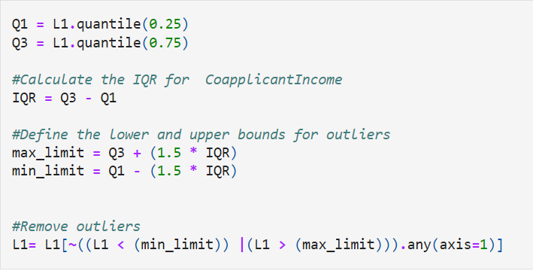
preprocessing
Reduce Feature
.
Outliers

Slide 14
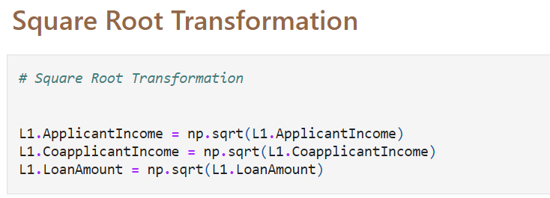
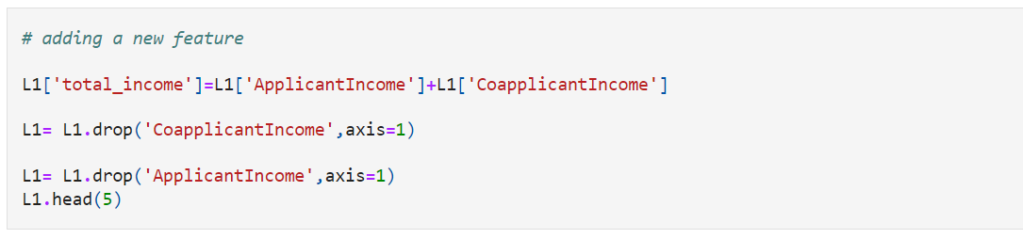
preprocessing
Transformation
.
Adding Features

Slide 15
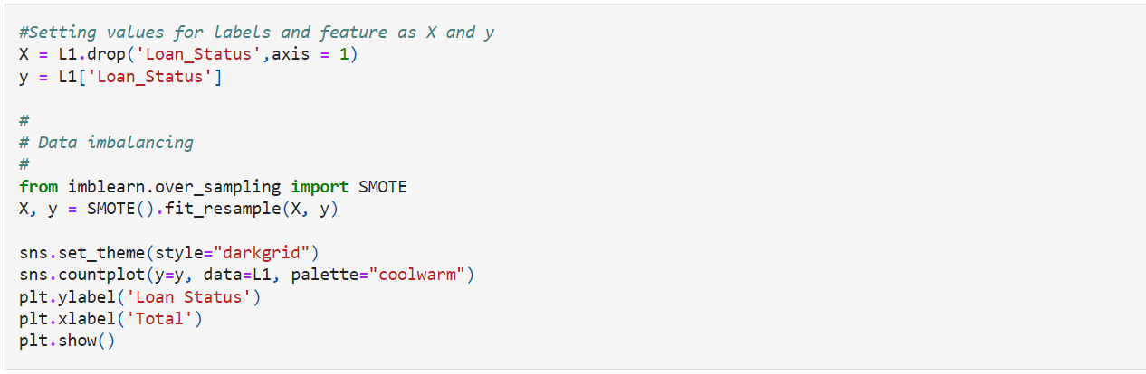
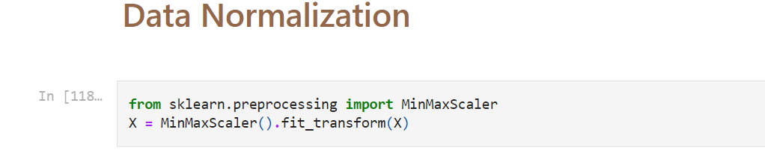
Splitting Data
Divide and scaling
.
Normalize

Slide 16
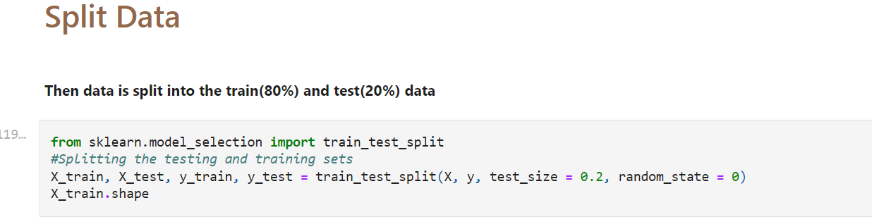
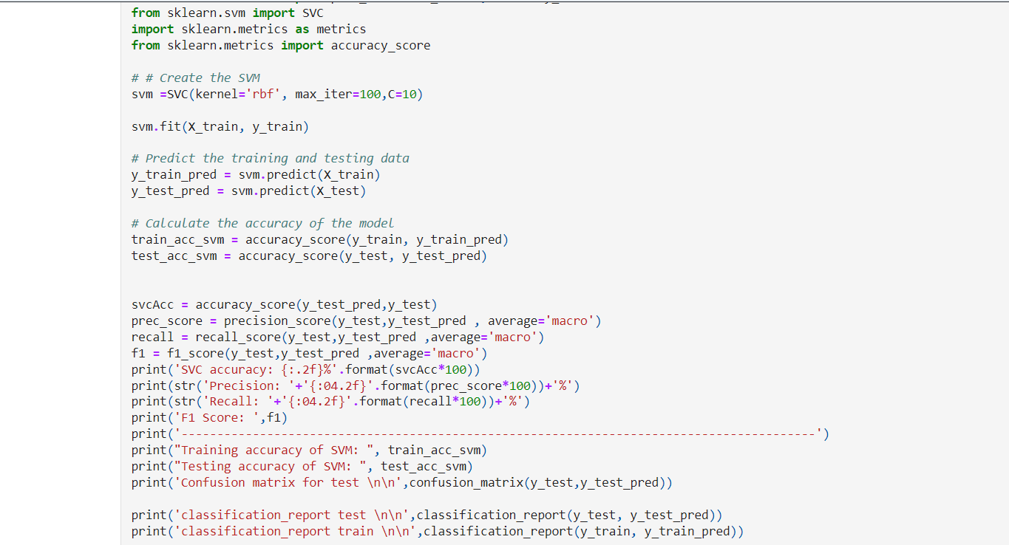
Splitting Data
Train &Test
.
SVM

Slide 17
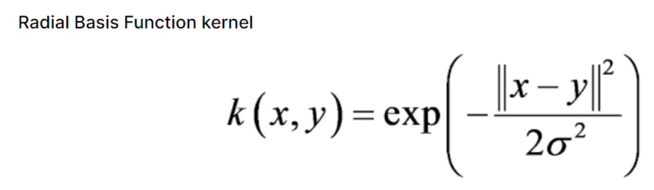
SVM
K(x, y) = exp(-gamma * ||x-y||^2)*
there are 4 popular kernels –
1-Linear kernel,
2-Polynomial kernel,
3-Radial Basis Function (RBF) kernel (also called Gaussian kernel)
4-Sigmoid kernel
RBF
a type of kernel function that can be used with the SVM classifier
to transform the data into a higher-dimensional space, where it is easier
to find a separation boundary. The RBF kernel is defined by a single parameter, gamma
which determines the width of the kernel and therefore
the complexity of the model. The RBF kernel function is defined as:

Slide 18
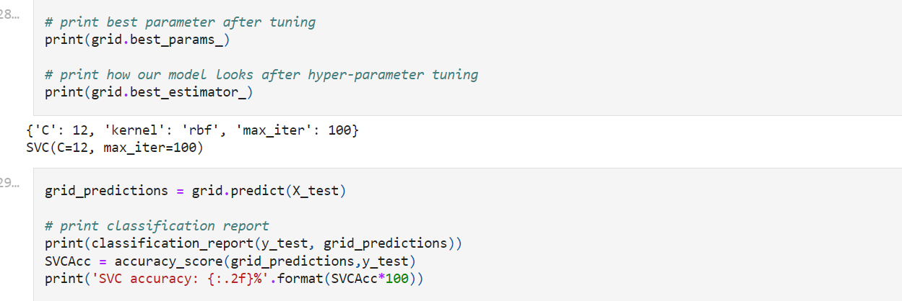
Grid Search SVM
takes a dictionary that describes the parameters that could be tried on a model to train it. The grid of parameters is defined as a dictionary, where the keys are the parameters and the values are the settings to be tested. This article demonstrates how to use the GridSearchCV searching method to find optimal hyper-parameters and hence improve the accuracy/prediction results

Slide 19
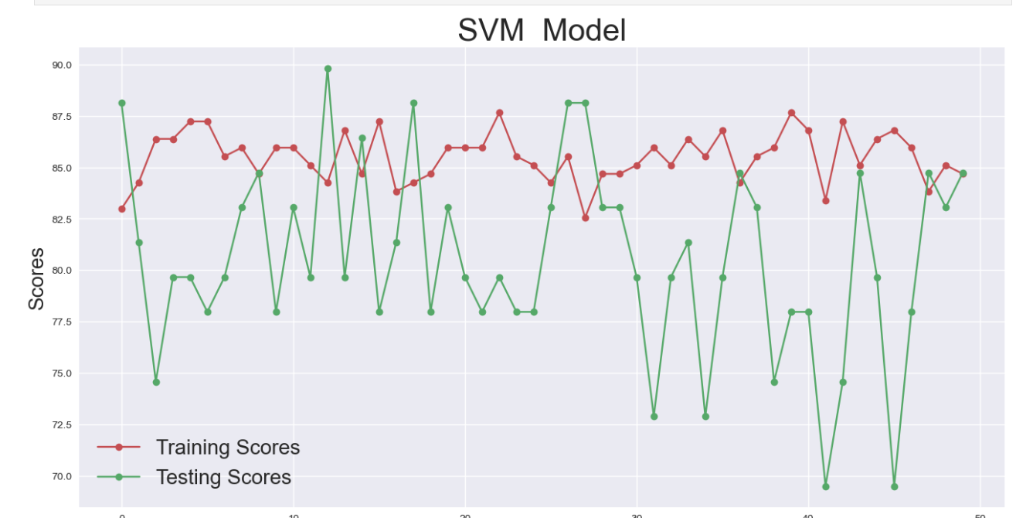
Performance of model

Slide 20
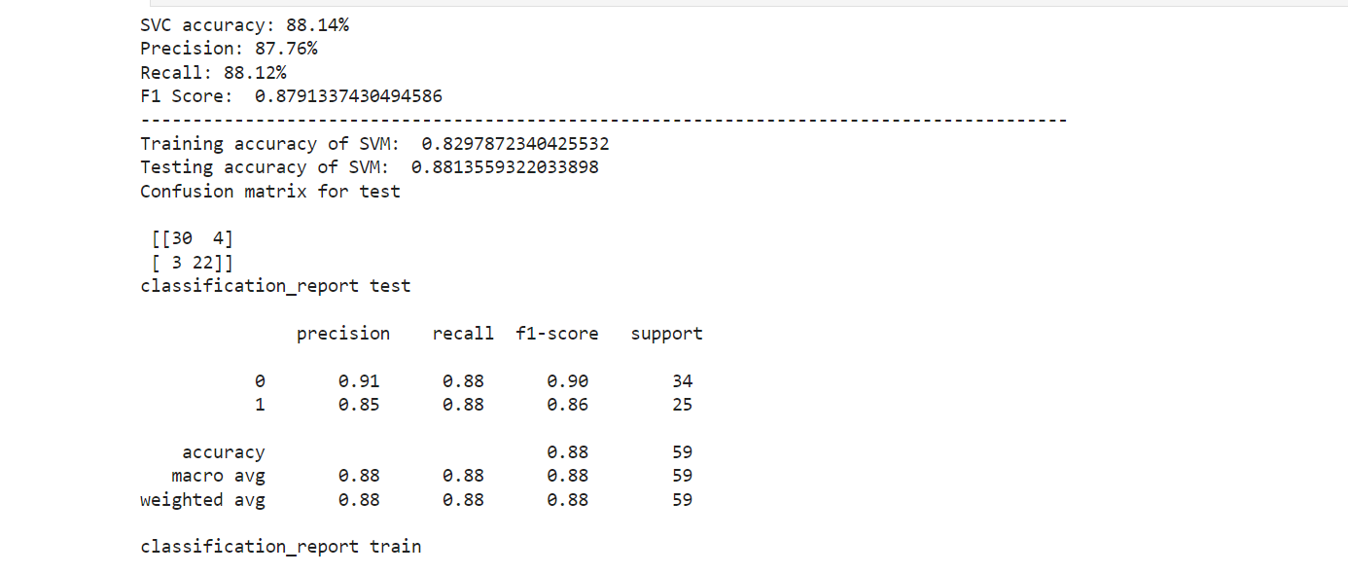
Performance of model Test

Slide 21
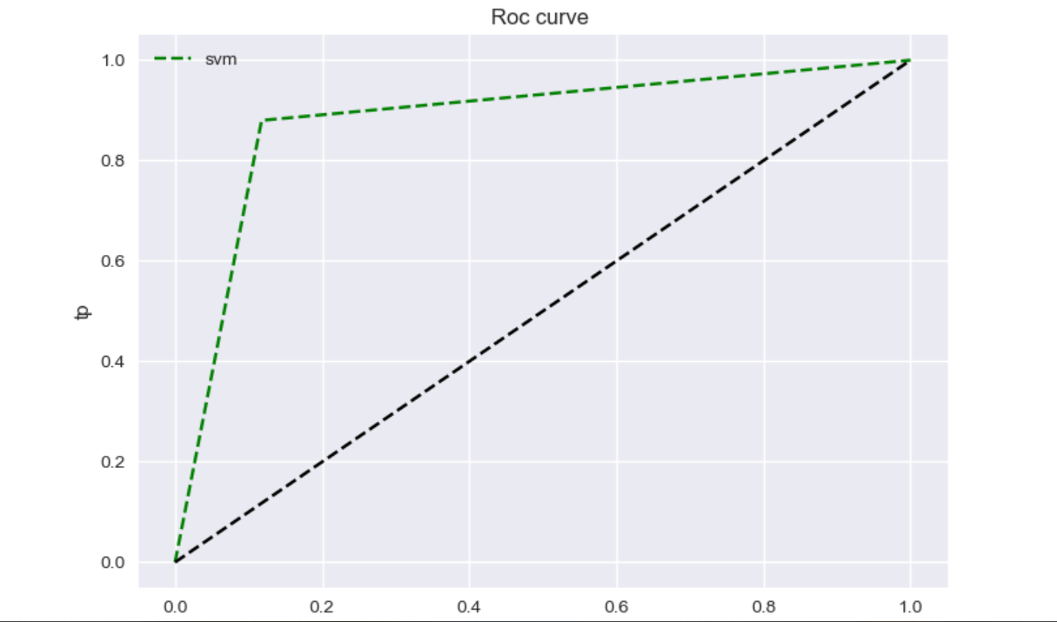
Performance of model Roc curve

Slide 22

Thank you
For Your Time

